Slide 1
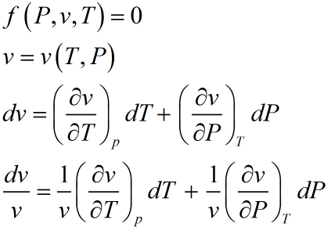


Equation of State for Simple compressible Substance
(pV work as only reversible work mode)
Isothermal
Compressibility
Volume expansion
Coefficient

Slide 2
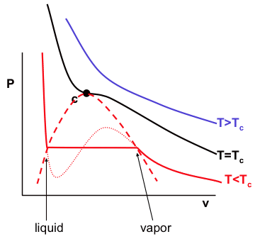
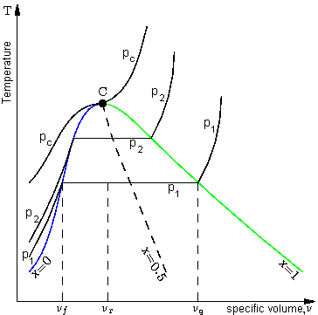
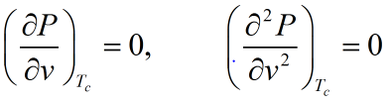
Mathematical Characteristic of Critical point

Slide 3

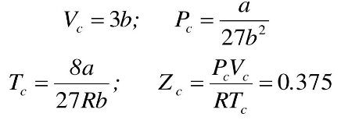
Van der Waals equation of state
Other equations of state (home work):
Virial equation,
Redlich-Kwong equation,
Benedict-Webb-Rubbin equation

Slide 4

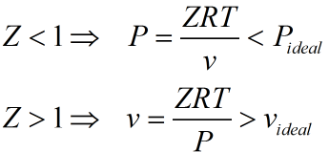
Compressibility Factor :
(a measure of extent of deviation from ideal gas behavior)
Intermolecular forces play major role
Actual volume of gas play a major role

Slide 5

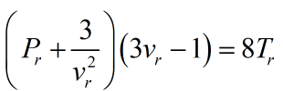
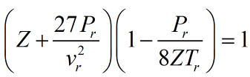
Reduced equation of state
(in terms of Z and )
(specific to a particular type of gasses following
same equation of state, not specific to a particular gas)

Slide 6

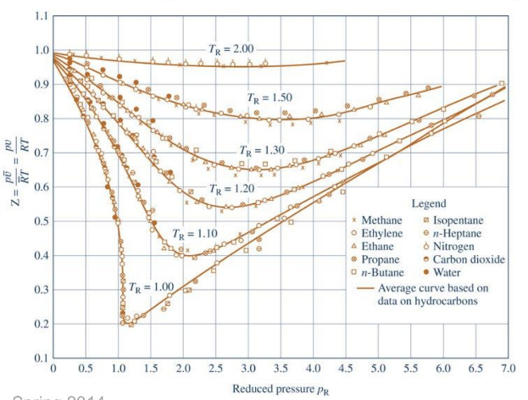
Generalized Compressibility Chart

Slide 7
Law of Corresponding States
According to van der Waals, the theorem of corresponding states (or principle/law of corresponding states) indicates that all fluids, for same set of reduced temperature and reduced pressure, have approximately the same compressibility factor and all deviate from ideal gas behavior to about the same degree.
Using reduced variables T_{r}, P_{r} and V_{r} , it is possible to generalize those properties which are dependent on intermolecular forces ( not really a scientific law per se, but more of a generalized relationship).
Two parameter model:

Slide 8
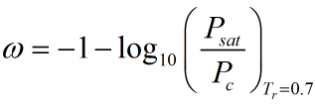


The Acentric Factor was first proposed by Pitzer, accounts for the deviation from prediction of two parameter model , especially for polar gases. He added a correction term by introducing third parameter, as given below:
where is known as simple fluid term (can be obtained using plot given in slide 6),
and
the second term is known as correction factor, chart for is available in books.

